Slide 1
INVENTORY
MANAGEMENT SYSTEM
PRODUCTS
Manage product records
SUPPLIERS
Database Project Presentation
Manage supplier details
PURCHASE & SALES
Track stock movement
Team Members
M Bharathi – 25B11CS530
G Harisha – 25B11CS280
Y Maheswari – 25B11CSA33
E Manikanta – 25B11CS255
DATABASE
SQL-based management

Slide 2
Introduction
WHAT IT IS
WHAT IT MANAGES
HOW IT WORKS
A database-based application used to manage and monitor inventory efficiently.
Products, suppliers, purchases, sales, and stock levels.
A centralized SQL database stores, retrieves, and manages inventory data.
KEY BENEFIT
Quick access, updates, and analysis of inventory information with accuracy and speed.

Slide 3
Problem Statement
DATA OVERLOAD
MANUAL ERRORS
Large amounts of inventory data are difficult to maintain.
Manual entry and calculations can cause errors.
STOCK TRACKING
REPORTING GAPS
Purchase and sales updates may be delayed.
Low-stock information and accurate reports may not be available on time.

Slide 4
Objectives
01
02
03
Stock Tracking
Track stock availability efficiently and identify low-stock products for timely restocking.
Accurate Records
Maintain accurate product and inventory records.
Supplier & Sales
Manage supplier, purchase, and sales information.
04
05
06
Reports
Generate useful inventory reports and demonstrate practical DBMS and SQL concepts.
Quick Retrieval
Provide quick searching and retrieval of records.
Reduce Erros
Reduce manual work and human errors across all operations.

Slide 5
End Users
Inventory Manager
Store Manager
Sales Staff
Monitors stock and updates inventory records.
Reviews purchases, sales, and reports.
Records sales and checks product availability.
Purchase Staff
Administrator
Records purchases and supplier information.
Manages system and database records.

Slide 6
System Requirements
FUNCTIONAL REQUIREMENTS
NON-FUNCTIONAL REQUIREMENTS
• Add, update, delete, and search products.
• Manage supplier information.
• Record purchase and sales transactions.
• Automatically update stock quantity.
• Generate reports and identify low-stock products.
• Security
• Reliability
• Performance
• Scalability
• Maintainability

Slide 7
Main Entities
Product
Category
Supplier
Database entity
Database entity
Database entity
Purchase
Purchase_Details
Customer
Database entity
Database entity
Database entity
Sales
Sales_Details
Employee
Database entity
Database entity
Database entity

Slide 8
Entities & Primary Keys
Product
Category
Supplier
PK: Product_ID
PK: Category_ID
PK: Supplier_ID
Purchase
Purchase_Details
Customer
PK: Purchase_ID
PK: Purchase_Detail_ID
PK: Customer_ID
Sales
Sales_Details
Employee
PK: Sales_ID
PK: Sales_Detail_ID
PK: Employee_ID

Slide 9
Relationships & Cardinalities
Category → Product 1 : M
Supplier → Product 1 : M
Supplier → Purchase 1 : M
Purchase → Purchase_Details 1 : M
Customer → Sales 1 : M
Employee → Sales 1 : M
Sales → Sales_Details 1 : M
Product → Sales_Details 1 : M

Slide 10
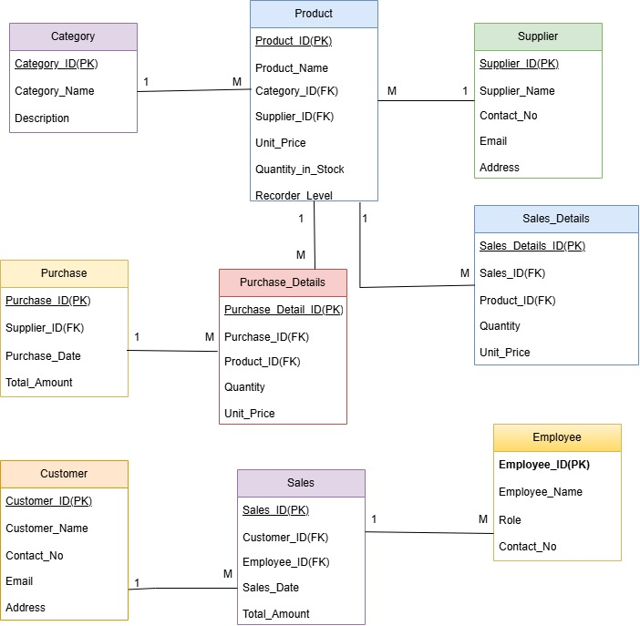



Relational Schema

Slide 11
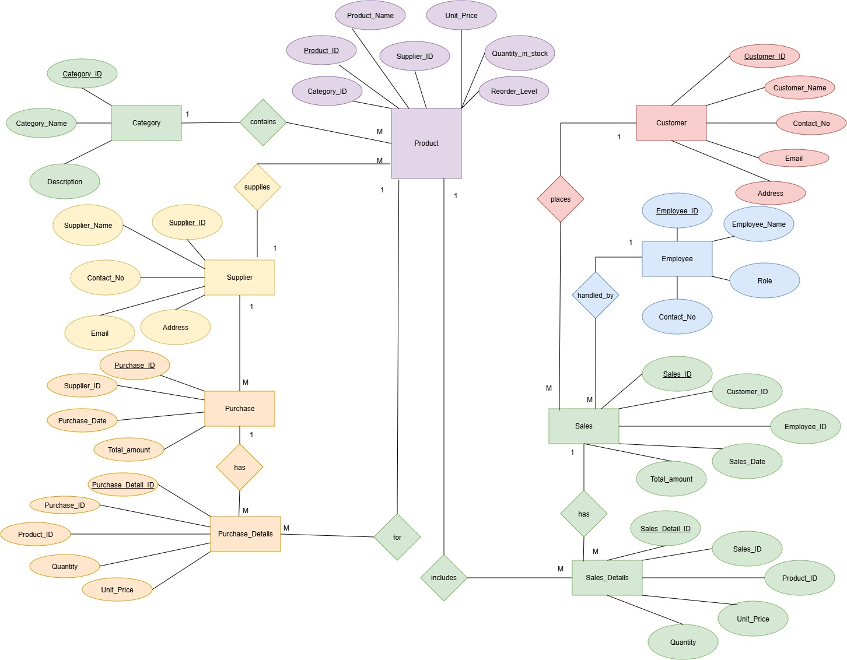

ER Diagram
The Entity-Relationship diagram below illustrates the structure and relationships of the Inventory Management System database.
Sales
Category
Product
Supplier
Purchase

Slide 12
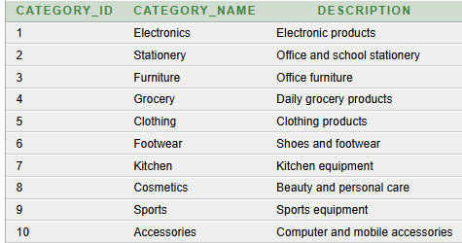
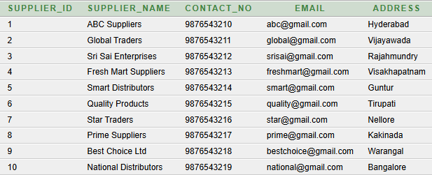
Table Creation
Category:
Supplier:
CREATE TABLE Category (
Category_ID NUMBER PRIMARY KEY,
Category_Name VARCHAR2(50) NOT NULL,
Description VARCHAR2(200)
);
CREATE TABLE Supplier (
Supplier_ID NUMBER PRIMARY KEY,
Supplier_Name VARCHAR2(100) NOT NULL,
Contact_No VARCHAR2(15),
Email VARCHAR2(100) UNIQUE,
Address VARCHAR2(200)
);
Output:
Output:

Slide 13
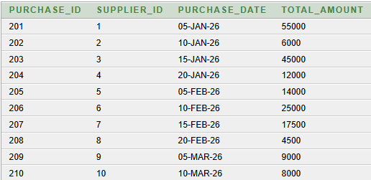
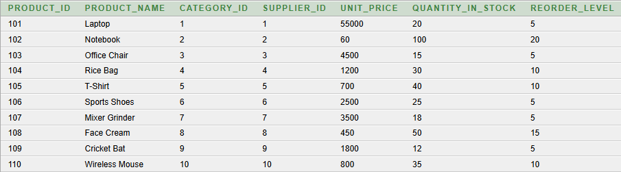
Table Creation
Product:
Purchase:
CREATE TABLE Product (
Product_ID NUMBER PRIMARY KEY,
Product_Name VARCHAR2(100) NOT NULL,
Category_ID NUMBER NOT NULL,
Supplier_ID NUMBER NOT NULL,
Unit_Price NUMBER(10,2) CHECK (Unit_Price >= 0),
Quantity_in_stock NUMBER DEFAULT 0 CHECK (Quantity_in_stock >= 0),
Reorder_Level NUMBER DEFAULT 10 CHECK (Reorder_Level >= 0),
CONSTRAINT fk_product_category
FOREIGN KEY (Category_ID)
REFERENCES Category(Category_ID),
CONSTRAINT fk_product_supplier
FOREIGN KEY (Supplier_ID)
REFERENCES Supplier(Supplier_ID)
);
CREATE TABLE Purchase (
Purchase_ID NUMBER PRIMARY KEY,
Supplier_ID NUMBER NOT NULL,
Purchase_Date DATE NOT NULL,
Total_amount NUMBER(12,2) CHECK (Total_amount >= 0),
CONSTRAINT fk_purchase_supplier
FOREIGN KEY (Supplier_ID)
REFERENCES Supplier(Supplier_ID)
);

Slide 14
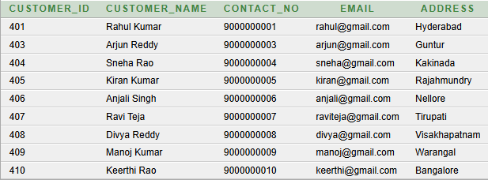
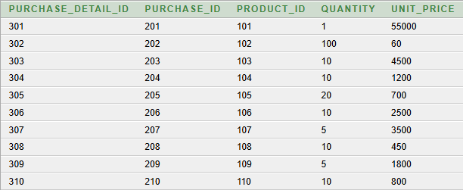
Table Creation
Purchase_Details:
CUSTOMER:
CREATE TABLE Purchase_Details (
Purchase_Detail_ID NUMBER PRIMARY KEY,
Purchase_ID NUMBER NOT NULL,
Product_ID NUMBER NOT NULL,
Quantity NUMBER NOT NULL CHECK (Quantity > 0),
Unit_Price NUMBER(10,2) CHECK (Unit_Price >= 0),
CONSTRAINT fk_pd_purchase
FOREIGN KEY (Purchase_ID)
REFERENCES Purchase(Purchase_ID),
CONSTRAINT fk_pd_product
FOREIGN KEY (Product_ID)
REFERENCES Product(Product_ID)
);
CREATE TABLE Customer (
Customer_ID NUMBER PRIMARY KEY,
Customer_Name VARCHAR2(100) NOT NULL,
Contact_No VARCHAR2(15),
Email VARCHAR2(100) UNIQUE,
Address VARCHAR2(200)
);

Slide 15
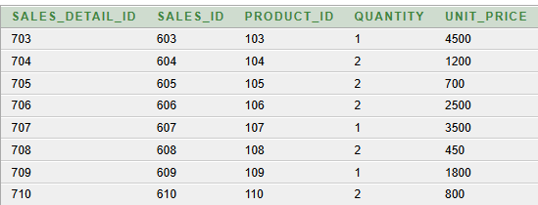
Table Creation
SALES_DETAILS:
CREATE TABLE Sales_Details (
Sales_Detail_ID NUMBER PRIMARY KEY,
Sales_ID NUMBER NOT NULL,
Product_ID NUMBER NOT NULL,
Quantity NUMBER NOT NULL CHECK (Quantity > 0),
Unit_Price NUMBER(10,2) CHECK (Unit_Price >= 0),
CONSTRAINT fk_sd_sales
FOREIGN KEY (Sales_ID)
REFERENCES Sales(Sales_ID),
CONSTRAINT fk_sd_product
FOREIGN KEY (Product_ID)
REFERENCES Product(Product_ID)
);

Slide 16
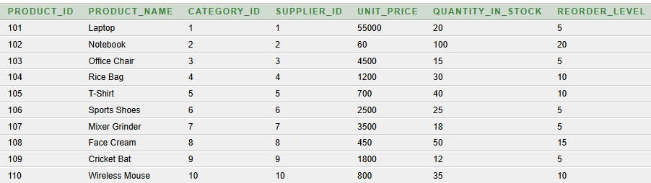
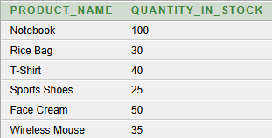
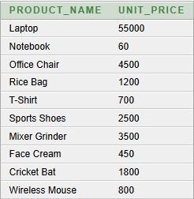
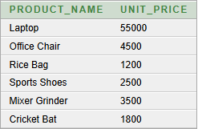
Queries
1. SELECT * FROM Product;
3. SELECT Product_Name, Quantity_in_stock
FROM Product
WHERE Quantity_in_stock > 20;
2. SELECT Product_Name, Unit_Price
FROM Product;
4. SELECT Product_Name, Unit_Price
FROM Product
WHERE Unit_Price > 1000;

Slide 17
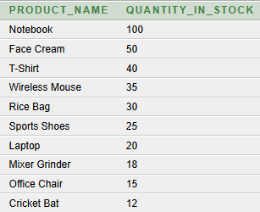
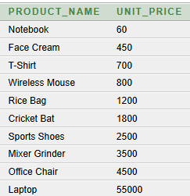

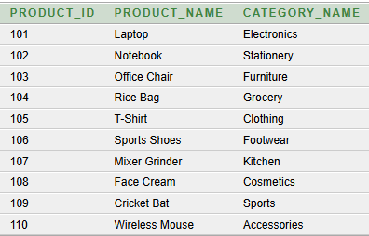
5. SELECT Product_Name, Unit_Price
FROM Product
ORDER BY Unit_Price ASC;
7. SELECT Product_Name, Quantity_in_stock
FROM Product
ORDER BY Quantity_in_stock DESC;
8. SELECT p.Product_ID,p.Product_Name,
c.Category_Name FROM Product p
JOIN Category c
ON p.Category_ID = c.Category_ID;
6. SELECT COUNT(*) AS Total_Products
FROM Product;

Slide 18
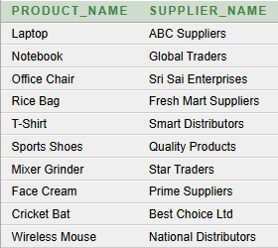
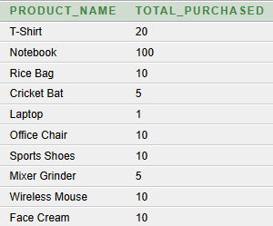
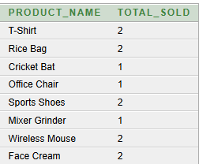
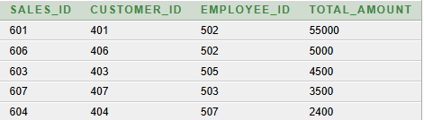

9. SELECT p.Product_Name,
s.Supplier_Name
FROM Product p
JOIN Supplier s
ON p.Supplier_ID = s.Supplier_ID;
10. SELECT p.Product_Name,
SUM(pd.Quantity) AS Total_Purchased
FROM Product p
JOIN Purchase_Details pd
ON p.Product_ID = pd.Product_ID
GROUP BY p.Product_Name;
11. SELECT p.Product_Name,
SUM(sd.Quantity) AS Total_Sold
FROM Product p
JOIN Sales_Details sd
ON p.Product_ID = sd.Product_ID
GROUP BY p.Product_Name;
12. SELECT Product_Name, Unit_Price
FROM Product
WHERE Unit_Price > (
SELECT AVG(Unit_Price)
FROM Product
);
13. SELECT Sales_ID, Customer_ID, Employee_ID, Total_amount
FROM Sales
WHERE Total_amount > 2000
ORDER BY Total_amount DESC;

Slide 19
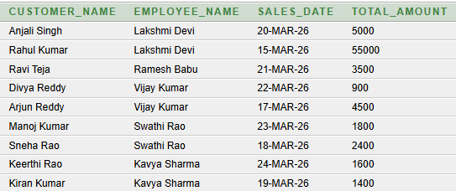
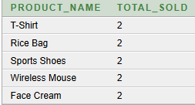
14. SELECT p.Product_Name,
SUM(sd.Quantity) AS Total_Sold
FROM Product p
JOIN Sales_Details sd
ON p.Product_ID = sd.Product_ID
GROUP BY p.Product_Name
HAVING SUM(sd.Quantity) = (
SELECT MAX(Total_Sold)
FROM (
SELECT SUM(Quantity) AS Total_Sold
FROM Sales_Details
GROUP BY Product_ID
)
);
15. SELECT c.Customer_Name,
e.Employee_Name,
s.Sales_Date,
s.Total_amount
FROM Sales s
JOIN Customer c
ON s.Customer_ID = c.Customer_ID
JOIN Employee e
ON s.Employee_ID = e.Employee_ID;

Slide 20
NORMALIZATION
Normalization is the process of organizing data in a database into well-structured tables to reduce data redundancy, avoid data duplication, and maintain data consistency and integrity.
It involves dividing large tables into smaller related tables and establishing relationships between them using keys.
Types of Normalization:
1NF (First Normal Form) :
  Values must be atomic.
  No repeating groups.
  Each record should be unique.
2NF (Second Normal Form)
  Must be in 1NF.
  No partial dependency.
  All non-key attributes depend on the complete primary key.
3NF (Third Normal Form)
  Must be in 2NF.
  No transitive dependency.
  Non-key attributes depend only on the primary key.

Slide 21
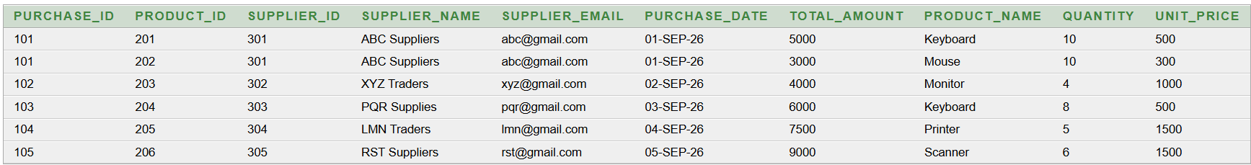
1NF (First Normal Form)
Each column contains atomic (single) values.
No repeating groups or multiple values in one cell.
Each row represents a unique record.
Each table should have a primary key.
Helps to reduce data duplication and improve data organization.
It is the first step of normalization.
FUNCTIONAL DEPENDENCIES:
Purchase_ID → Supplier_ID, Supplier_Name, Supplier_Email, Purchase_Date, Total_Amount
Product_ID → Product_Name
Primary Keys: (Purchase_ID, Product_ID).

Slide 22
2NF ( SECOND NORMAL FORM)
A table must be in 1NF.
There should be no partial dependency.
Every non-key attribute must depend on the entire primary key.
It mainly applies when the table has a composite primary key.
It helps reduce data redundancy and improve data consistency.
FUNCTIONAL DEPENDENCIES:
Purchase_ID → Supplier_ID, Supplier_Name, Supplier_Email, Purchase_Date, Total_Amount
Purchase_ID → Supplier_ID → Supplier_Name, Supplier_Email
Purchase_Detail_ID → Purchase_ID, Product_ID, Quantity, Unit_Price

Slide 23
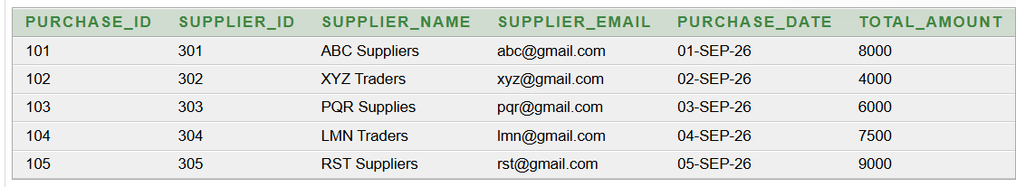
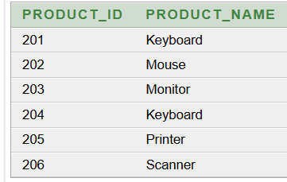
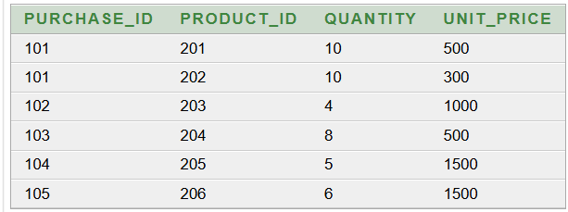
Primary Key: (Purchase_ID)
Primary Key: (Product_ID)
Primary Keys: (Purchase_ID, Product_ID).

Slide 24
3NF ( THIRD NORMAL FORM)
The table must be in 2NF.
There should be no transitive dependency.
Non-key attributes must depend only on the primary key.
Separate independent information into different related tables.
Helps to reduce redundancy and maintain data consistency.
FUNCTIONAL DEPENDENCIES:
Supplier_ID → Supplier_Name, Contact_No, Email, Address
Purchase_ID → Supplier_ID, Purchase_Date, Total_amount
Purchase_Detail_ID → Purchase_ID, Product_ID, Quantity, Unit_Price

Slide 25
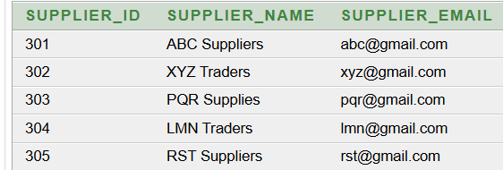
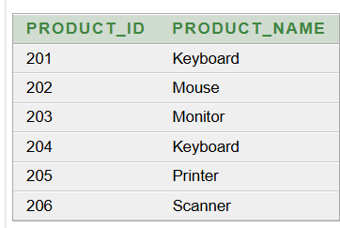
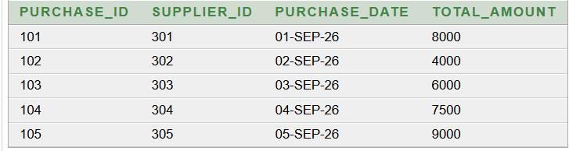
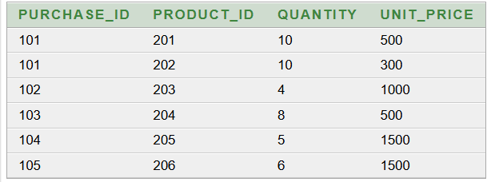
Primary Key: Supplier_ID
Primary Key: Purchase_ID
Primary Keys: (Product_ID).
Primary Key: Purchase_ID,Product_ID

Slide 26
Conclusion
The Inventory Management System provides an efficient and organized way to manage products, suppliers, purchases, sales, customers, and employees. The system uses SQL, primary keys, foreign keys, and integrity constraints to maintain accurate and consistent data. The database is normalized up to 3NF, which helps reduce data redundancy and improve data consistency. SQL queries make it easier to store, update, retrieve, and analyze information. Overall, the system reduces manual work, improves inventory management, and provides a reliable foundation that can be further enhanced with low-stock alerts, barcode scanning, report generation, dashboards, and mobile access.

Slide 27
Thank You

